Slide 1
CHAPTER 2
IMAGES
PIXELS

Slide 2


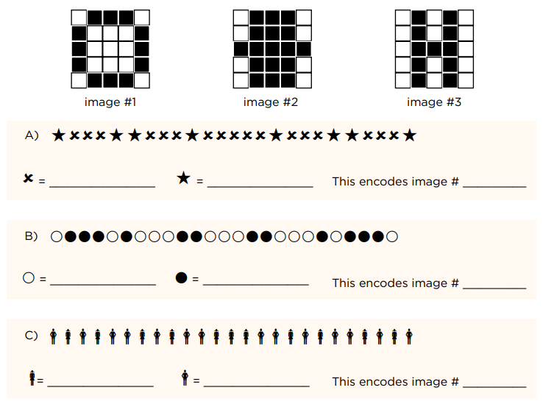
PRACTICE
EXERCICE 1
Answers on paper
05 MIN
INDIV

Slide 3

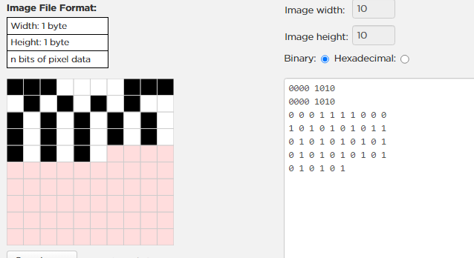


DEMO
How to use the pixel editor ?
05 MIN
https://studio.code.org/s/pixelation/lessons/1/levels/1
Define the image size
Define a white pixel
Define a black pixel
0 = TURN LIGHT OFF => BLACK
1 = TURN LIGHT ON => WHITE

Slide 4
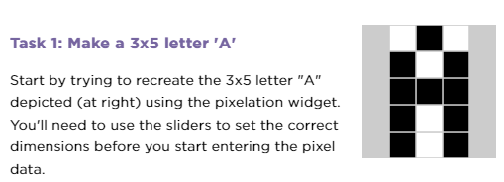
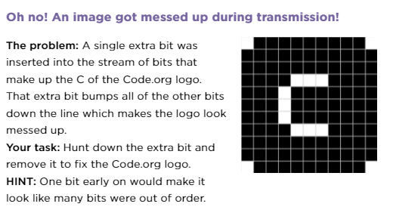
PRACTICE
Let’s use the pixel editor !
15 MIN
INDIV
CHALLENGE 1
CHALLENGE 2
https://studio.code.org/s/csp1-2021/lessons/7/levels/2?no_redirect=1
https://studio.code.org/s/csp1-2021/lessons/7/levels/3?no_redirect=1

Slide 5
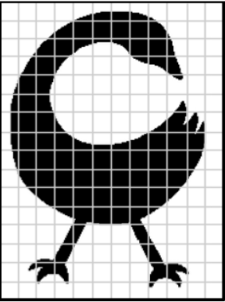
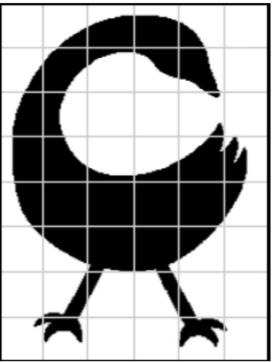
PRACTICE
EXERCICE 2
15 MIN
INDIV
Answers on paper
Use the pixel editor
Notes:
Read values from Challenge A (black or white for each square) and input the values into the app.
After Challenge A, answer the questions on paper
Repeat for Challenge B.

Slide 6


PRACTICE
EXERCICE 3
15 MIN
INDIV
Draw your favorite logo on paper
Decide how you are going to sample this logo
Draw the logo in one of the 4 grids
Recreate the logo sing the pixel editor
Show it to a classmate. Do they recognize the logo? Make adjustments if needed

Slide 7
DISCUSS
10MIN
GROUP 3
What are the + and - of sampling an image more frequently?
= increase the number
of pixels
Notes:
Allow students time to think, then have them share in pairs or groups of four. Call on a few students to share with the whole class.
Discussion Goal: We want students to start seeing that there are advantages and disadvantages as a result of decisions we make when we represent data digitally. Some key points to draw out from students:
Pros: We get a much more smooth/clearer/accurate representation of the analog image. A little easier to decide whether to make a square black or white.
Cons: More bits are needed. Took longer to enter in the widget. Still doesn’t look exactly like the analog image. Still had many squares that contained both black and white, so decisions had to be made to choose one over the other.
Remarks
Thank you for sharing. It looks like there are several advantages and disadvantages when it comes to sampling more frequently by using smaller squares. We get a better approximation of the analog image when we do more frequent sampling and it was a little easier to decide whether each square should be set to black or white. However, it took longer and we needed a lot more bits. We still got an image that didn’t represent the image accurately enough, though.
Fortunately, a computer does this process much more quickly than we can, and it can store thousands or even millions of bits to represent an analog image.
By this point, we've used bits to represent numbers, text, and images. The same sequence of bits can represent different types of data depending on the context. It all comes down to 0s and 1s!

Slide 8

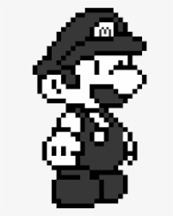
HOMEWORK
Draw contest
INDIV
Using the pixel editor, draw your best black and white pixel image
Submit it on google classroom
Jury the next session to vote !

